Slide 1
Driving SMR Adoption
不翻
Western Digital – Internal Use Only
Customer requirements for SMR HDDs
HDD BU & Global Sales Enablement
July 2023

Slide 2
Driving SMR Adoption
Motivation and value proposition snapshot
SMR (Shingled Magnetic Recording) is a relatively new industry-standard HDD recording technology that delivers multiple customer benefits
Higher capacities vs. traditional CMR HDDs (at least one capacity generation ahead)
TCO improvements
Western Digital has enhanced SMR to deliver even higher capacities, out-pacing the competition
UltraSMR and OptiNAND are WDC-proprietary technologies that deliver value, while maintaining 100% compatibility
While some applications may have lower Write performance with SMR HDDs, Read performance on SMR is comparable to CMR HDDs
SMR is a core HDD-industry technology and will be shipping for the long-term future
SMR is an evolutionary technology that enables growth above CMR capacities and will be used to further increase HAMR HDD capacities
Earlier adopters of SMR HDDs will have a competitive edge
SMR users will have access to the highest HDD capacities available in the market
Hyperscale customers are rapidly adopting SMR
Not all customers can adopt SMR HDDs easily
SMR is a “drop-in” solution for specific customer and application types
Some customers and applications will require significant software development investment to adopt SMR

Slide 3
What is an SMR HDD?
The one-page SMR HDD primer
Zone
Conventional HDD
Data in discrete tracks
Device controls data placement
Host-Managed SMR HDD
Data in zones of overlapped tracks
Applications control data placement in zones
Historically HDDs have used CMR
“Conventional Magnetic Recording”
Supports completely random read and write operations
SMR increases HDD capacity with a novel recording method
“Shingled Magnetic Recording” overlaps data tracks in groups called “zones”
Data must be written sequentially, but can still be read randomly
SMR HDDs can be “Drive-Managed” or “Host-Managed”
Drive-managed emulates traditional block devices and performance can vary wildly
Host-Managed relies on host software (OS/driver/filesystem) being aware of drive architecture and managing writes appropriately
SMR is a key component of WDC’s UltraSMR, a collection of Western Digital technologies that can deliver capacity beyond basic SMR

Slide 4
UltraSMR and OptiNAND
Western Digital delivers more than the competition with our proprietary technologies
SMR System
Distributed Sector
+
=
TDMR
Soft Track ECC
MORE CAPACITY SOONER (Always 1+ generation ahead)
UltraSMR
OptiNAND
These technologies are core building blocks for Western Digital’s SMR drives today and into the future
UltraSMR is a Western Digital brand name for a combination of features that provide capacity gains and align with SMR technology and its associated sequential write restrictions
UltraSMR incorporates multiple features from prior generations as well as newly introduced capabilities enabled by OptiNAND
OptiNAND is Western Digital’s customized iNAND used to accelerate internal HDD operations beyond standard caching
UltraSMR and OptiNAND improve HDD resilience and performance, while providing leading capacities with 4+ terabytes more than CMR drives

Slide 5
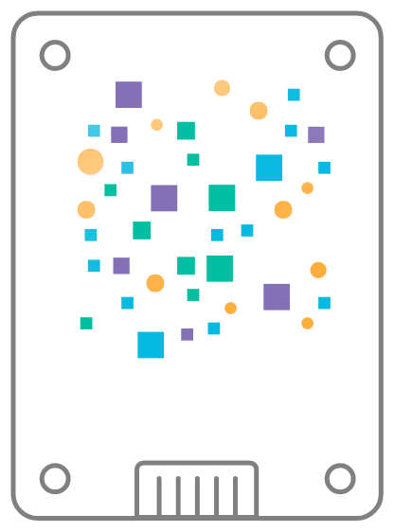
Zoned Storage
SMR HDDs are part of a larger ecosystem
“Zoned Storage” is a class of storage devices that enable the host system and the storage devices to cooperate to achieve higher storage capacities
Zoned Storage involves organizing or partitioning the drives into zones
SMR HDDs
ZNS (Zoned Namespace) SSDs
A big benefit of the Zoned Storage ecosystem is that software changes to support ZNS help support SMR, and changes to support SMR help enable ZNS
Defines a unique HDD/SSD device type and behavior
Only sequential writes allowed within defined zones
Write locations enforced by different command set and device type
For more information: www.westerndigital.com/zoned-storage

Slide 6

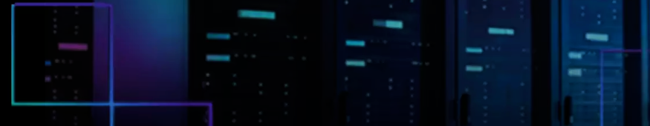
Benefits of SMR
WHY your customer should consider WDC SMR HDDs
Core Benefits
TCO Benefits
SMR delivers higher capacity HDDs, enabling denser systems with a lower $/TB
SMR HDDs offer significant capacity bump over conventional recording:
WDC 2023 HDD programs offer 22TB in CMR, 26TB in SMR
Western Digital’s products feature UltraSMR, delivering value beyond competitive SMR
More capacity: Grow your data, not your footprint or infrastructure
Service providers can reduce capital expenses (fewer servers, racks, networking, space, etc.)
System builders can provide a denser, more competitive solution
Lower overall power
Even at the same $/TB price, customers will realize overall cost savings

Slide 7
SMR-Friendly vs. SMR-Aware
Two paths for the customer to adopt SMR HDDs
What is an “SMR-Friendly” Application?
What is an “SMR-Aware” Application?
Existing applications where writes are heavily sequential, e.g., WORM (Write-Once, Read-Many) or…
Environments where storage density is more important than write performance, such as cold/archival storage and smart video
An application & software stack that has been custom-designed and optimized by the customer to follow SMR write rules
Encompasses the entire stack (i.e. Application, Filesystem, OS, etc.)
Most any application can be re-written to be SMR-Aware
Customer re-writes the entire software stack to use SMR HDDs
Benefit: SMR HDDs perform like CMR HDDs across a broader set of applications
Customers use “btrfs” filesystem to “hide” SMR complexity from SMR-friendly applications
Benefit: Enables “Drop-In” adoption of SMR HDDs with faster, low-cost path for some applications

Slide 8
Implementing an “SMR-Friendly” Solution
SMR Can Be a Drop-In Solution for Some Applications
Benefits
How to Implement
Shortest, easiest time-to-market option for customers
Faster time-to-revenue for WDC
Write performance at near-parity with CMR HDDs
Read performance at parity with CMR HDDs
Customer requirements:
SMR-Friendly application
Linux kernel version >5.17
btrfs filesystem
Not Recommended: “SMR-Unfriendly” Applications
Existing applications with higher Random Writes and/or updates can exhibit very unpredictable write performance

Slide 9
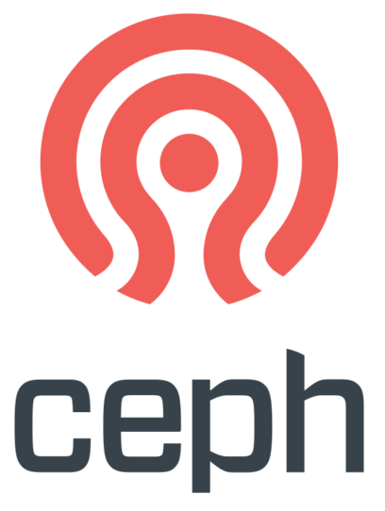
SMR-Friendly Application Examples
Targeting ideal customer-types for SMR sales opportunities
Smart Video / Surveillance Customers have been testing SMR
Cloud Backup Dropbox successfully deployed SMR*
Cold / Archival Storage Write Once, Read Many (WORM) applications
Content Delivery Networks Low-Write, Heavy-Read applications
Storage-based Cryptocurrency Chia tested SMR successfully
Select Cloud Storage With versioning, edits are not overwritten in-place
Ceph-based Object Storage Native support available in 2024
Many of your customers are likely to be using “SMR-Friendly” applications and can benefit from the values that SMR HDDs deliver
*https://dropbox.tech/infrastructure/four-years-of-smr-storage-what-we-love-and-whats-next

Slide 10
“DIY” SMR Implementation
More difficult implementation path delivers customer and application flexibility
Pros
Cons
How to Implement
“DIY” solution enables predictable write performance for most any workload
Requires significant software development investment
Not all customers have the technical capability to develop SMR-Aware application stacks
Long time to revenue
Entire application software stack needs to be re-written by the customer to be SMR-Aware & Optimized, following SMR write rule
Requirements:
Operating system support for host-managed SMR (Linux kernel >4.10)
Drivers and firmware to interact with SMR drives efficiently
Raw block access: Application stack interacts directly with physical or logical blocks, bypassing standard file system
Write optimization and performance tuning, along with “garbage collection” to enable wear-leveling, track utilization & erasure

Slide 11



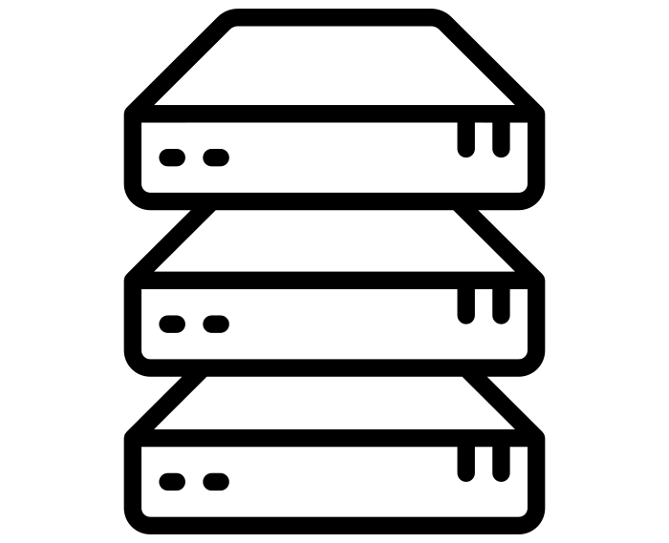

Can Your Customer Use SMR HDDs?
The answer requires a short dialog…
If
Yes
Can the solution use Linux Kernel >4.10?
Does the solution use Linux?
Does the solution not use RAID?
Is HDD access in single-drive or JBOD mode?
Can the storage controller (HBA) pass-through SMR commands?
Can the customer modify OR choose a Linux kernel version?
Is the application SMR-Aware or can the customer customize their entire software stack?
If
No
Is the application SMR-Friendly?
Can the solution use Linux Kernel >5.17?
Can the solution use the btrfs filesystem?
If your solution meets the checked boxes, SMR would be a good fit for you

Slide 12
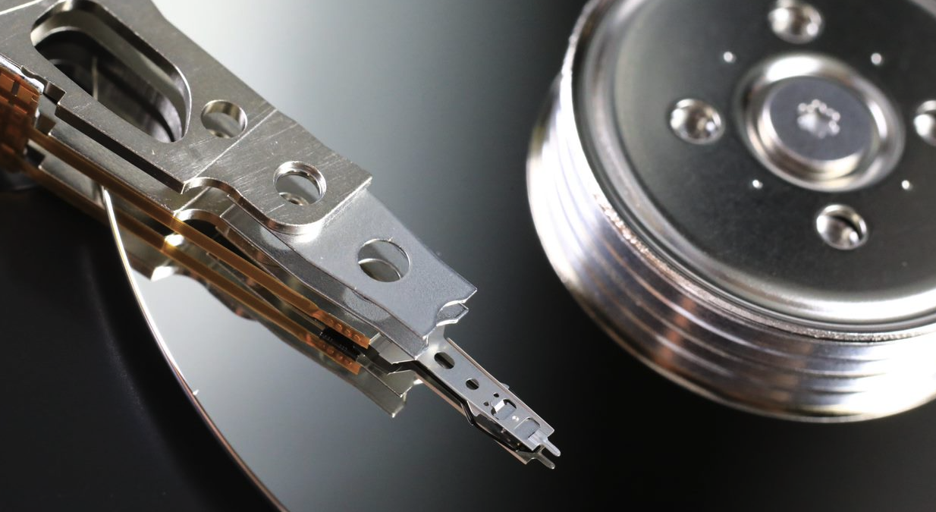

Engaging with the Customer
不翻
Can your Customer use SMR?
Use the pre-requisites chart (“Can Your Customer Use SMR HDDs?”) with your customer’s technical leads
Most customers are likely to follow the drop-in “SMR-Friendly” path
Customers with “SMR-Friendly” applications can more easily adopt SMR
Ensure the customer understands:
They may see a write performance impact with “SMR-Friendly” applications
The “SMR-Aware” path requires significant software development and investment
Following-up with the Customer
If your customer can use SMR:
What is the customer TAM?
What is the existing buying relationship with WD?
What is the existing technical support on the account (internal and external)?
Will the customer be willing to co-market their solution upon deployment?
Ensure you drive the competitive value of WDC UltraSMR and OptiNAND (vs. competing SMR products)
Engage with HDD Technical Marketing for next steps

Slide 13
Backup
不翻

Slide 14
Additional Resources
不翻
Western Digital Internal Use Only
HDD Technology Resources
Western Digital Zoned Storage initiative site provides additional information on ZNS
https://www.westerndigital.com/company/innovations/zoned-storage
Western Digital white papers and technical briefs
Zoned Storage for HDD and SSD Technologies
Shingled Magnetic Recording (SMR) HDD Technology
UltraSMR Technical Brief
Reimagining HDDs with OptiNAND Technology
Industry Zoned Storage Site
https://zonedstorage.io/
Technical Resources (Developers)
Passthrough tools and libraries
libzbc (https://github.com/westerndigitalcorporation/libzbc)
sg3utils (http://sg.danny.cz/sg/sg3_utils.html)
libnvme and nvme-cli (https://github.com/linux-nvme)
System tools and libraries
libzbd (https://github.com/westerndigitalcorporation/libzbd)
util-linux (https://github.com/karelzak/util-linux)
blkzone utility added with version 2.30.0
Benchmarking
fio (https://github.com/axboe/fio/) supports host-managed zoned block devices since version 3.9
zonemode=zbd option

